Slide 1
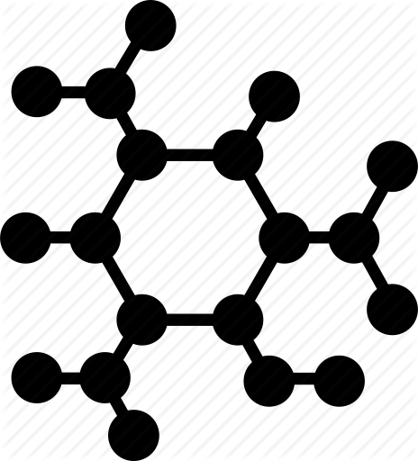
INSTRUCTIONS
DO NOT USE A COLOR BACKGROUND
KEEP ALL CONTENT WITHIN THE GOLD AND BURGUNDY BARS (other than title etc., and logo as shown here)
DO NOT CHANGE THE SIZE OF THE POSTER or alter/add to the Northrop Grumman footer
PLEASE KEEP THE TEXT READABLE. AVOID USING FANCY FONTS OR FONTS SMALLER THAN 36 pts
THE SIZE IS ALREADY SET TO EXACTLY THE PRINT SIZE. PLEASE ARRANGE AND SIZE ALL THE IMAGES AND TEXT PROPERLY.
PLEASE TRY TO ENSURE THAT ALL IMAGES ARE ATLEASE 300 DPI
THE NAME OF ANY FACULTY SHOULD BE PUT IN AS “Dr. [First Name] [Middle Initial]. [Last Name], Dept. of [Name of Department], [Name of Institution]
NAMES OF ANY SPONSORS, MENTORS, VOLUNTEERS, HELPERS, ETC. CAN BE PUT IN THE ACKNOWLEDGEMENTS SECTION. PUT IN TEXT ONLY. DO NOT PUT IN ANY ADDITIONAL LOGOS IN THE POSTER OTHER THAN THE ONES ALREADY IN THE TEMPLATE.
Your Poster file should be named as follows:
Showcase2018_POSTER_Capstone Major_YourTeamName (ex. Showcase2018_POSTER_AE_WINDS)
For your “Category”, please use:
Please place the symbols from those shown below for any category that is represented within your project in the top right corner of your poster. For example if your project is aerospace engineering and the project includes electrical work, and computer programming the symbols for aerospace engineering, electrical and electronics engineering, and computer sciences will be placed as shown above.
Please follow all instructions above
**delete this text box, arrow and the example symbols**

Slide 2
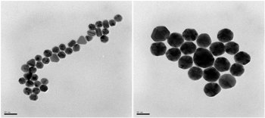
Nanoparticle Aggregation
By: Alan Daou, Ayo Adebisi, & Colin Breslin

Slide 3
Goals
Create a MATLAB code
Display nanoparticles behavior
Avoid aggregation

Slide 4
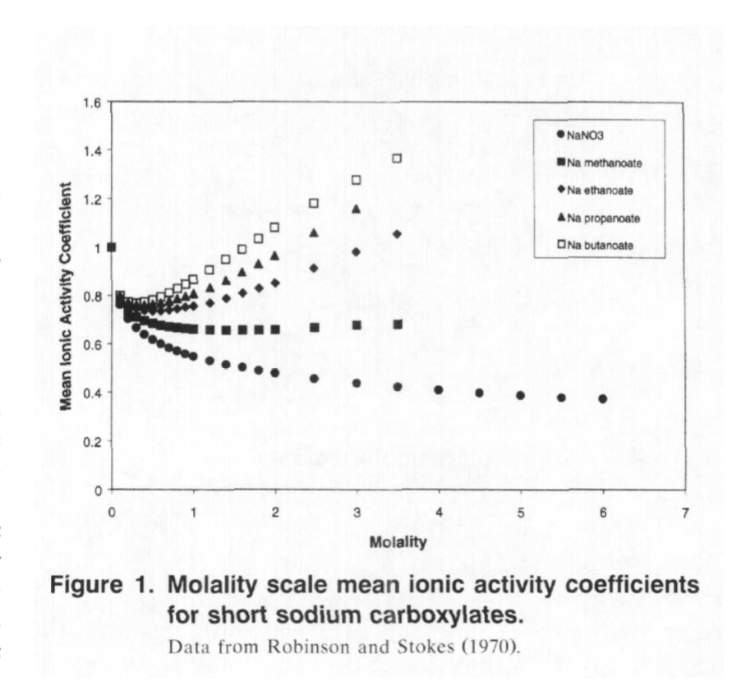
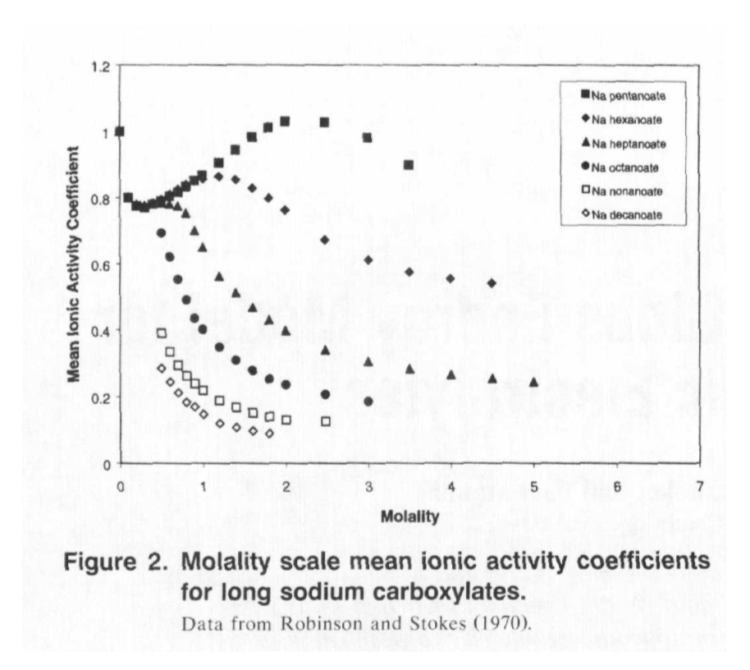
Literature Review of
Molecular Dynamics and Modeling
Data from Robinson and Stokes of
Mean Ionic Activity Coefficients of Organic Acids

Slide 5
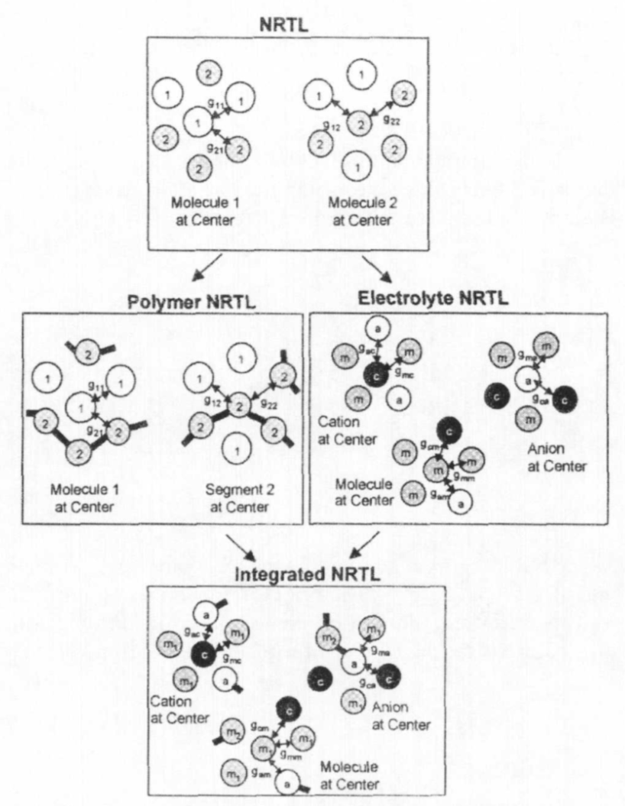
Steps Through Model Development

Slide 6
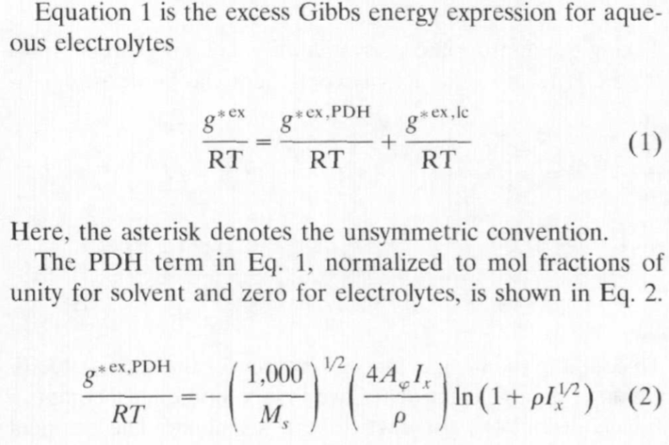

Slide 7
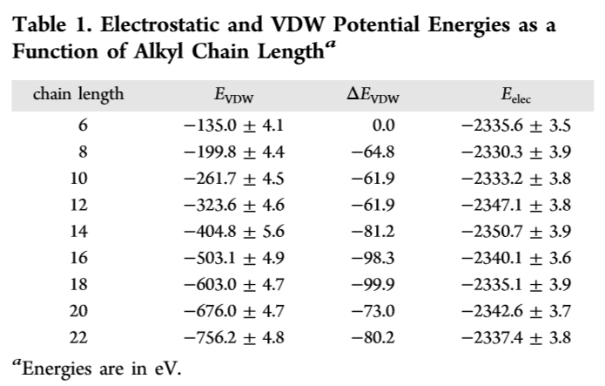
Table of Energies as a Function of
Alkyl Chain Lengthª

Slide 8
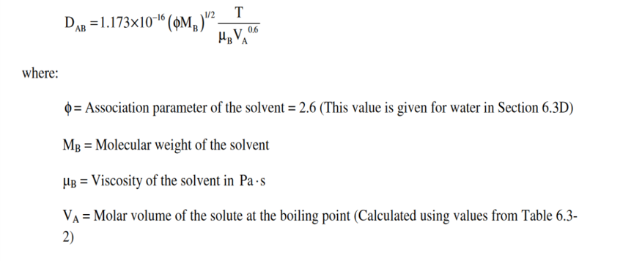

Slide 9
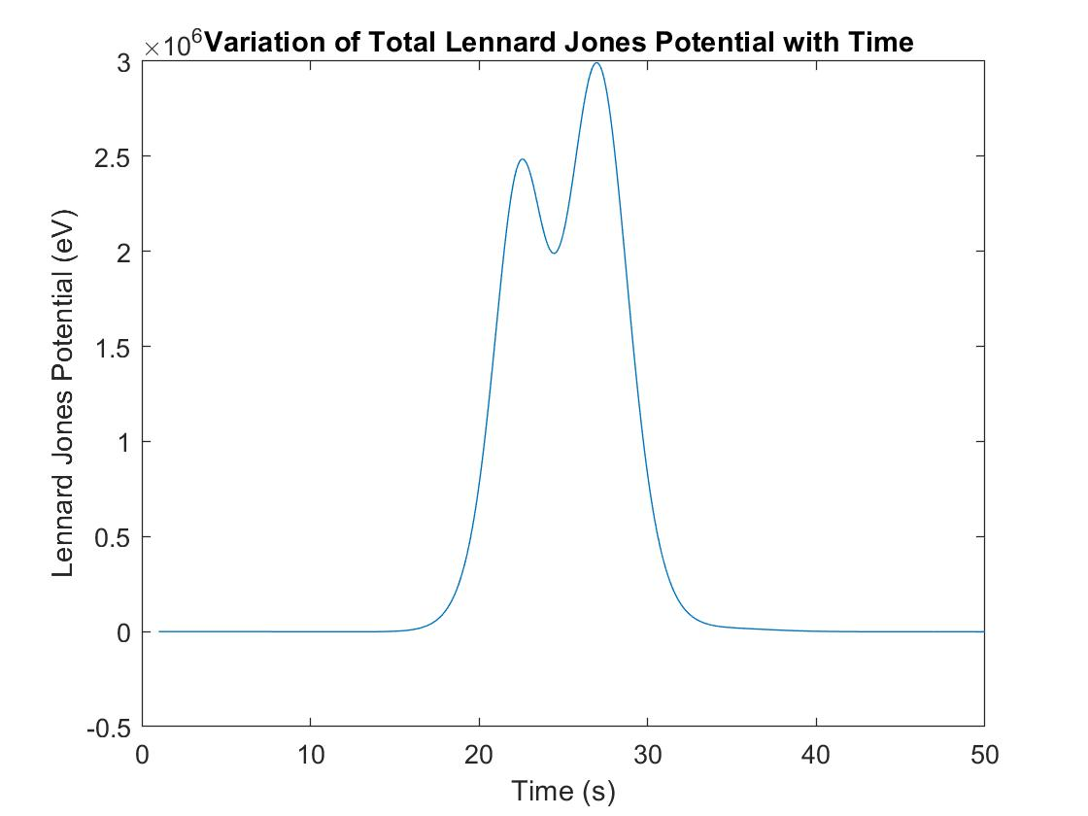
Intermediate Results with 30 Particle System

Slide 10
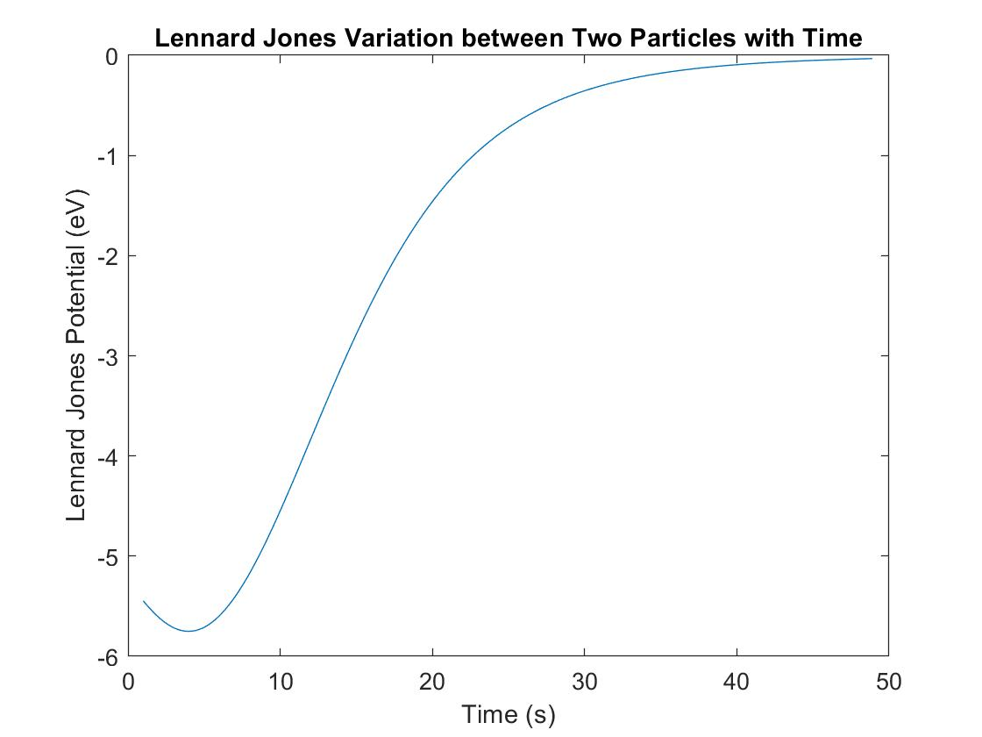
Intermediate Results Cont’d

Slide 11
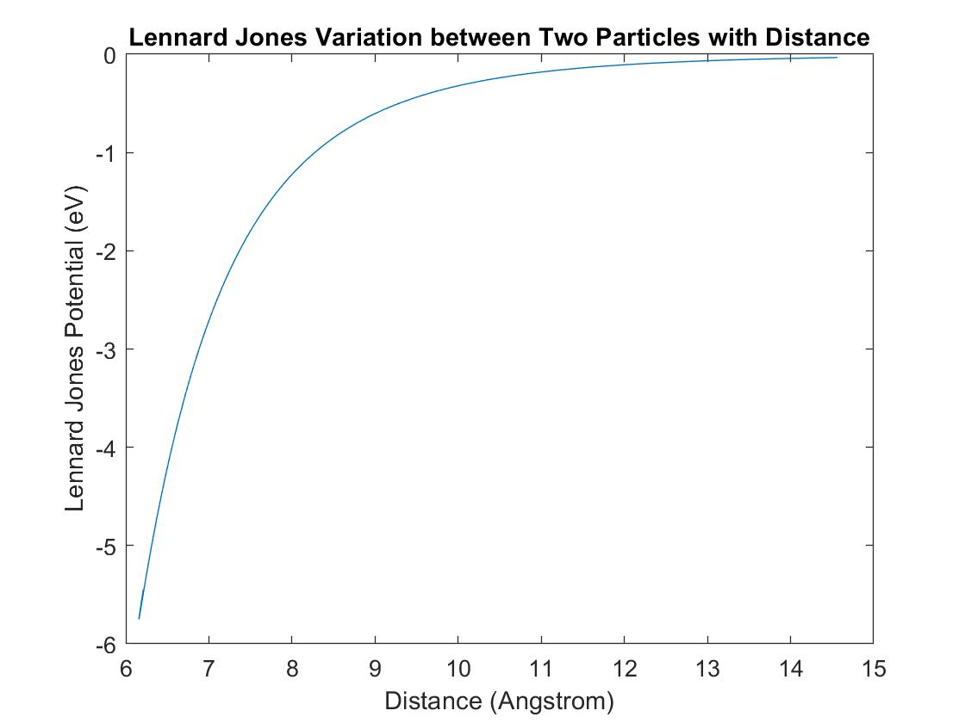
Intermediate Cont’d

Slide 12
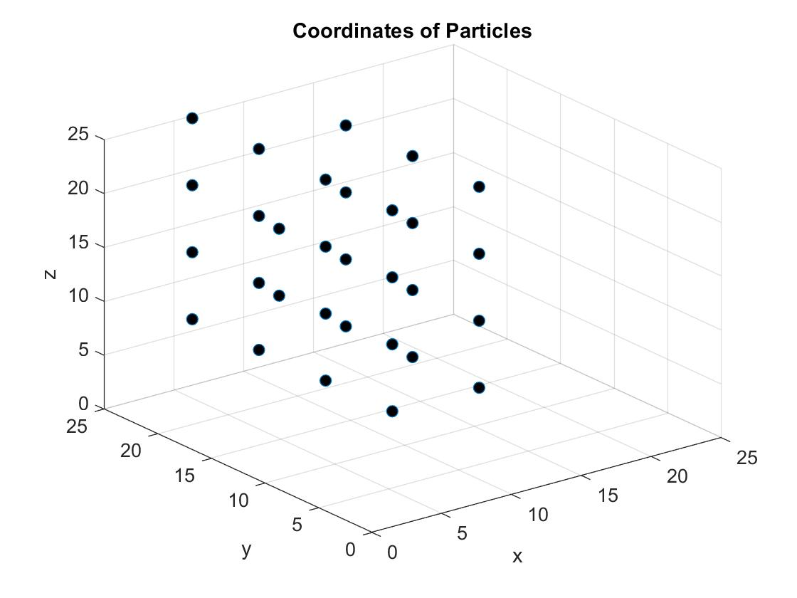
Grid Space, t = 0s

Slide 13
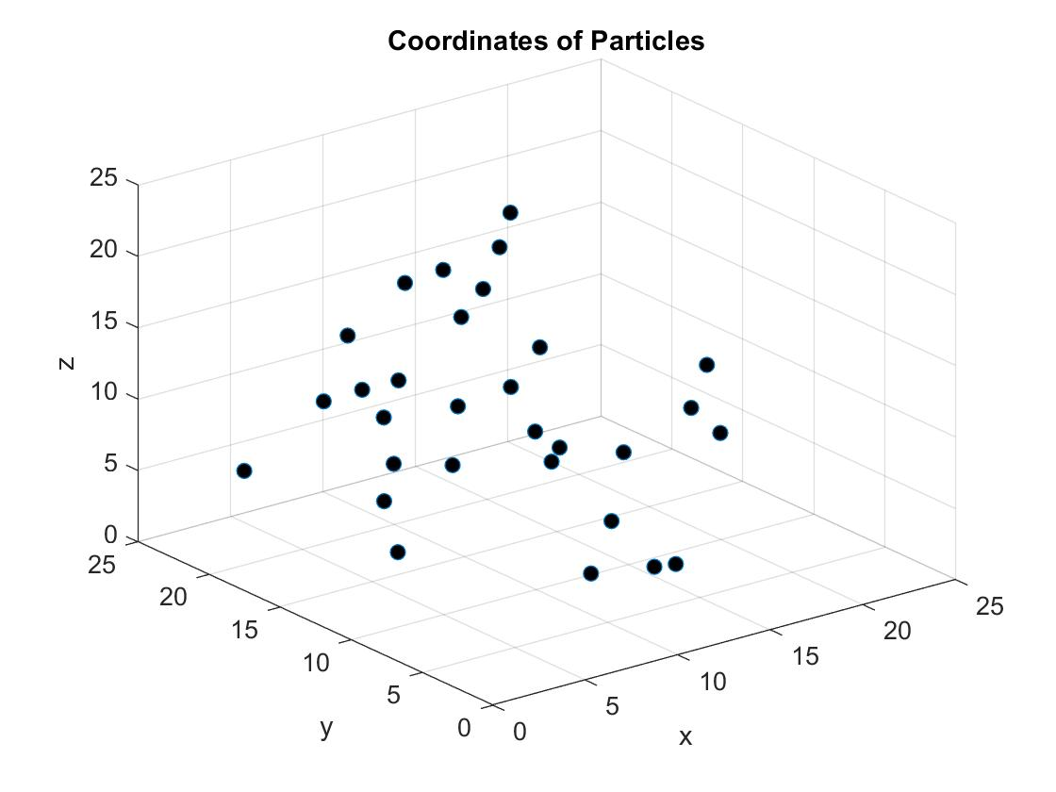
Grid Space t = 25s

Slide 14
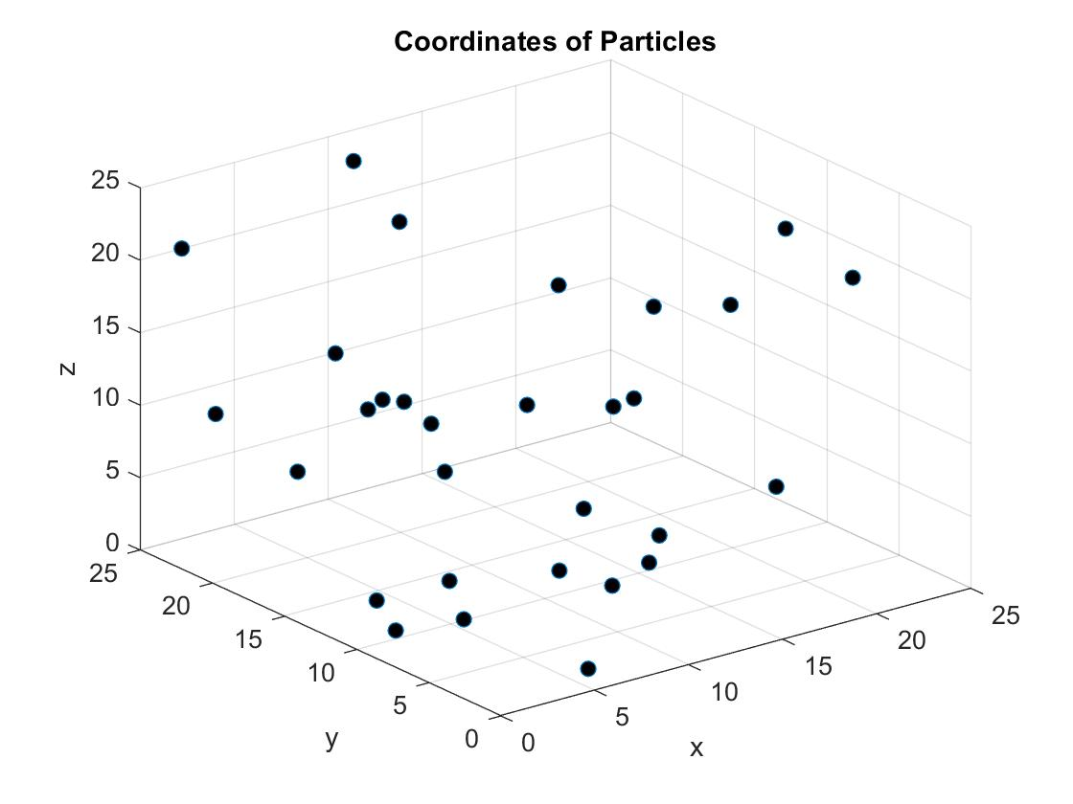
Grid Space, t = 50s

Slide 15

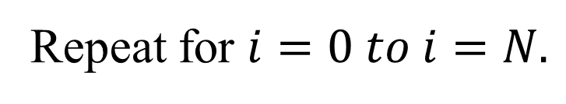

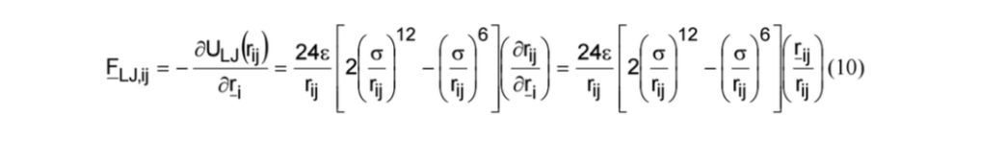
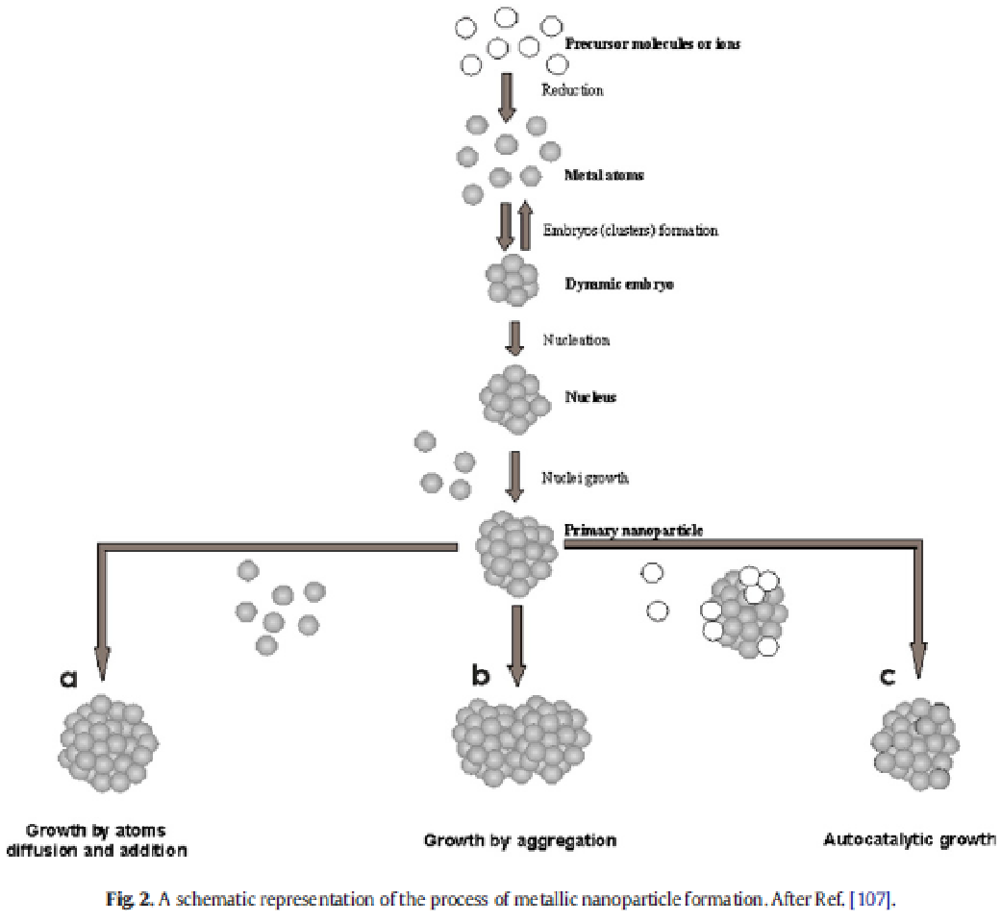
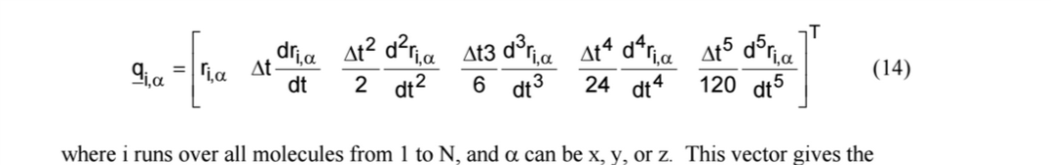
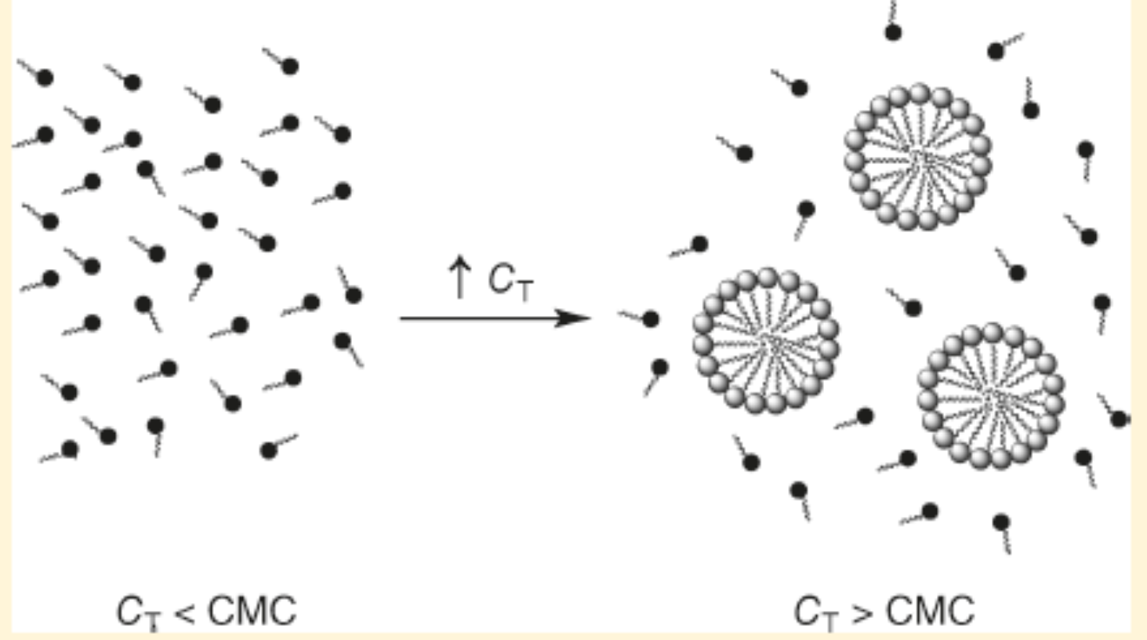
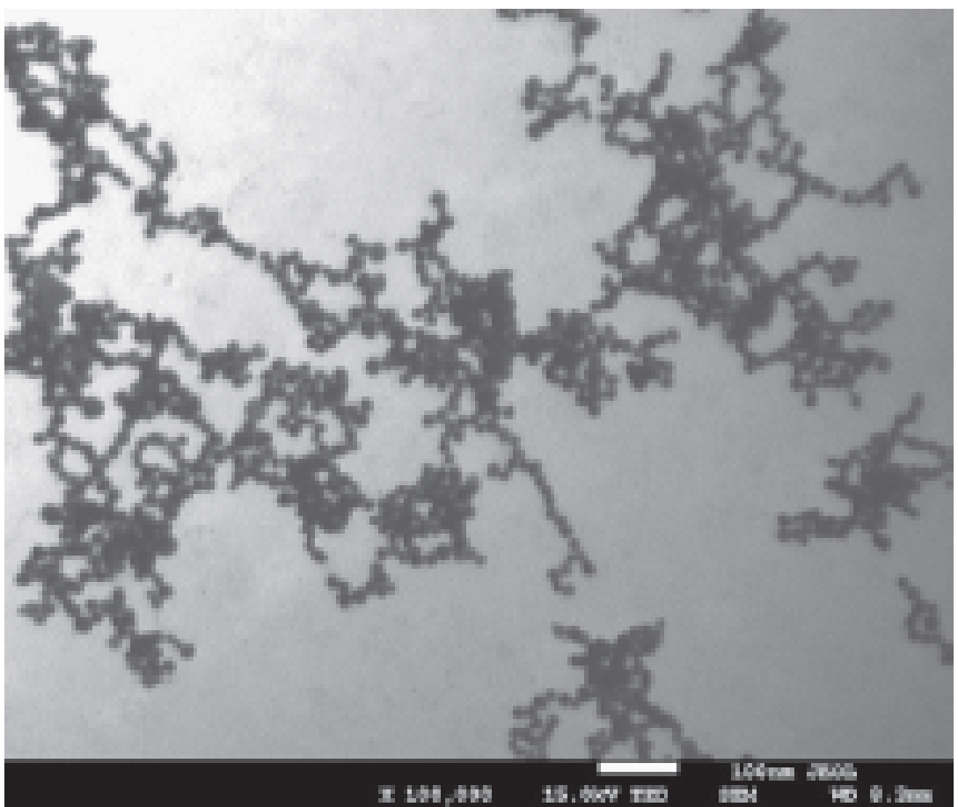
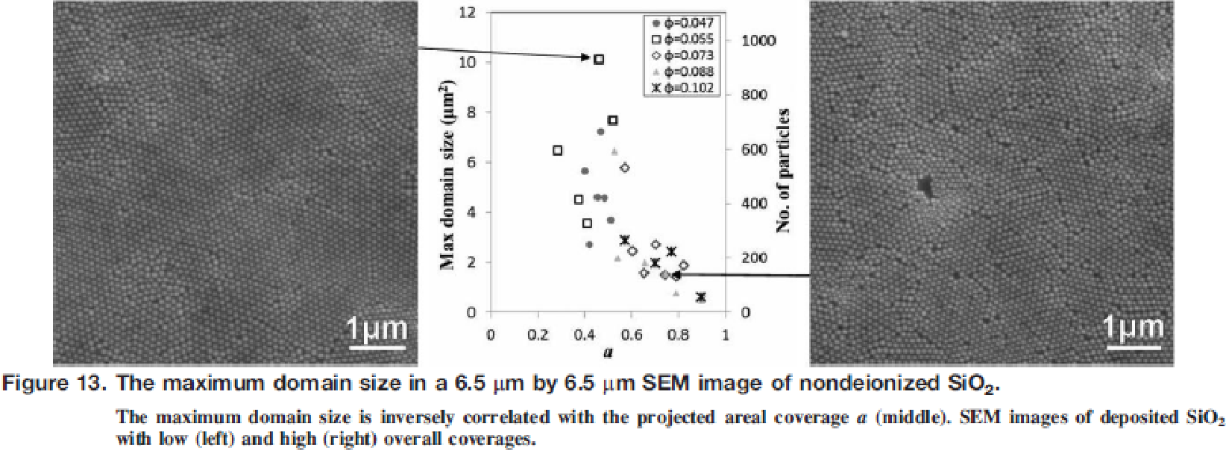
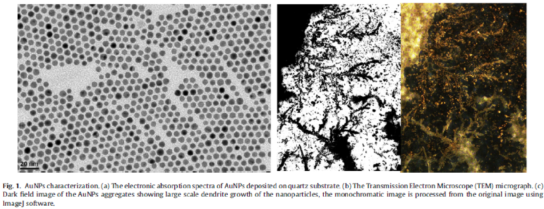
Simulation of Nanoparticle Aggregation
Ayo Adebisi, Colin Breslin, Alan S. S. Daou
Faculty Advisor: Dr. James Brenner Dept. of Chemical Engineering, Florida Institute of Technology
Abstract
Algorithm
For particle i sort neighbor list by distance, where nearest neighbor gets index 0.
In each time step, we must account for
A) any metal ions or atoms diffusing
B) any metal ions or atoms convectively moving due to ion currents
C) any nanoparticle (NP) diffusion
D) any NP convective motion
E) possible reaction between all combos of
1) two isolated metal atoms/ions
2) one metal atoms/ions + one NP
3) two NP's
F) Surface diffusion of metal within a NP to minimize NP energy
G) Include formation of grain boundaries
H) Include coalescence of two adjacent grains into one larger grain
Control over the distribution of particle sizes is central to the nanotechnology industry, particularly with regard to color, electrical properties, catalytic behavior, sensing by electronic noses and tongues, and all other surface properties. To make this possible, nanoparticles (NPs) are typically surrounded by either cationic or anionic surfactants to put a surface charge on the NP’s, thereby ensuring repulsion with similarly charged NP’s. Sometimes NP’s are surrounded by nonionic capping agents that rely solely on the steric bulk of the capping agent to provide a barrier to NP aggregation. Often, capping agents are chosen to provide both an electrostatic and a steric barrier to aggregation.
This project will involve the development of a hybrid Monte Carlo (MC) and molecular dynamics (MD) simulation of nanoparticles in an appropriate suspension fluid (as opposed to a solvent) such that the capped NP’s will have a finite chance of interacting with each other and/or with desorbed capping agent ligands. The MD portion of the simulation will approximate the electrokinetic (diffusion plus an electrically-driven convective flow), ultrasonic, and gravitational flows present in NP suspensions. The Monte Carlo portion of the model will simulate the probability for desorption or adsorption of a capping agent ligand with a NP, as well as the reaction of two NP’s with each other to form a single larger nanoparticle.
Start
Check particle j’s neighbor’s list for i. If particle i is found, update Lennard-Jones value for particle i in particle j’s neighbor list.
Read and Set Input Data
Lennard Jones (LJ) Calculator
Use LJ calculation to determine next positions of particles.
Task Plan
Determine nearest neighbors. Sort between short-range and long-range using r_{cut}.
n
Create system of NxNxN grid with initial positions of nanoparticles
Literature Review of Molecular Dynamics and Monte Carlo Simulations
Generate random initial velocities
Creation of an NxNxN grid with initial positions of nanoparticles
An initialization of all variables subroutine
A Lennard-Jones (LJ) energy function calculator
A nearest neighbors subroutine
Use LJ calculations to determine the next positions of particles
Output positions of particles onto a grid in movie form
Equilibration subroutine
Complete first simulation of Au ions and NP’s in solution forming nanoparticulate aggregates
Adding in the effects of different types of surfactants/soaps (at different concentrations) in the model. These surfactants are meant to reduce the possibility of aggregation.
Assign each molecule or atom a position, a velocity and an acceleration.
Repeat until system reaches equilibrium.
Output positions on 3D grid and energy data of particles and system.
Call Equilibration
Output positions on 3D grid and energy data of particles and system.
Identify each type of atom/molecule.
Move particles to newly generated position and energy data.
Literature Review
Nanoparticle Aggregation
Segment-Based Excess Gibbs Energy Model for Aqueous Organic Electrolytes – These are ionic liquids that are the capping agents & surfactants for nanotechnology.
Intermediate Code Results
5th Order Gear Predictor Corrector Method
The graph to the left displays the potential after the equilibrium bond energy. The cubic plots above display the atoms’ positions. The circled atoms indicate the atoms are too close and want to react. However, the code does not have anything for the atoms to react with at this time.
Ocwieja, et al., Adv. Coll. Interface Sci., 222 (2015) 530-563.
Ocwieja, et al., J. Coll. Interface Sci., 376 (2012) 1-11.
Abdellatif, et al., J. Coll. Interface Sci., 458 (2015) 266-272.
Lau and Russel, AIChE Journal, 60 (2014) 1287-1302.
Marcolongo & Mirenda, J. Chem. Educ., 88 (2011) 629-633.
Chen, Fluid Phase Equil., 241 (2006) 103-112.
Chen et al., AIChE Journal, 47 (2001) 2593-2602.
Keffer, D., The Working Person’s Guide to Molecular
Dynamics Simulations, Univ. of Tennessee-Knoxville,
http://utkstair.org/clausius/docs/mse614/text/notes.html

